Slide 1
Regulatory Program Brief
Michael S. Jewell
Chief, Regulatory Division
U.S. Army Corps of Engineers, Sacramento District
16 July 2021

Slide 2
OVERVIEW
Area of Responsibility
CA Central Valley and Sierra Nevada, NV, and UT
Highly diverse area climatically, topographically, politically
Challenges: endangered species, cultural resources, Tribes, public interest
Execution
600 permit decisions (95% by General Permit)
350 jurisdictional determinations
20 enforcement actions resolved
Organization
42 people in 4 offices across 3 states
Report directly to District Commander
Funding
General Regulatory Functions (GRF)
Section 214 of Water Resources Development Act

Slide 3
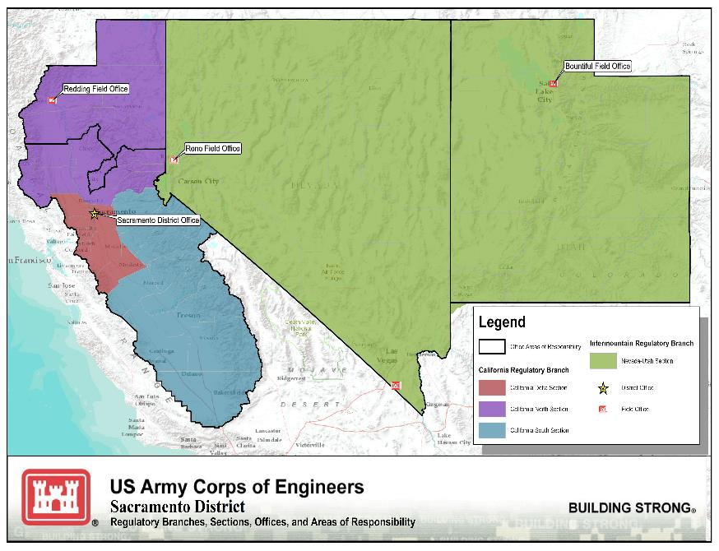

Slide 4
PROGRAM UPDATE
National
2020 Navigable Waters Protection Rule (definition of waters of the U.S.)
AZ Court Ruling – Now pre-2015 regulatory regime
Rulemaking to rescind and replace with “durable” regulation
2020 Section 401 of CWA Rule
Request certification and apply for Corps permit concurrently
2021/2022 Nationwide Permits
Regional
South Pacific Division Notice on WOTUS Regional Roundtables
Development of Regional General Permit for Wildfires in CA
Local
Programmatic Agreement with UT SHPO under Section 106 of NHPA

Slide 5
CUSTOMER RESOURCES
HQUSACE Website (https://www.usace.army.mil/)
National program info
Final and pending permit actions; Approved Jurisdictional Determinations
National Customer Service Survey link
Sacramento District Website (https://www.spk.usace.army.mil)
Submission of jurisdiction requests and permit applications
Latest News
Public Notices - sign up!
Regulatory Program Workshop materials
National Customer Service Survey link
Regulatory Program Workshops
Next: January 21, 2022 (Subject TBD)
Michael Jewell
(916) 557-6605
michael.s.jewell@usace.army.mil

