Slide 1
Regulatory Program Brief
Michael S Jewell
Chief, Regulatory Division
US Army Corps of Engineers, Sacramento District
23 October 2020

Slide 2
Overview
Area of Responsibility
CA Central Valley and Sierra Nevada, NV, UT, and CO Western Slope
Highly diverse area climatically, topographically, politically
Challenges: endangered species, cult. resources, Tribes, public interest
Execution
800-1000 permit decisions (95% by General Permit)
500 jurisdictional determinations
50 enforcement actions resolved
Organization
50 people in 6 offices across 4 states
Report directly to District Commander
Funding
General Regulatory Functions (GRF)
Section 214 of Water Resources Development Act of 2000

Slide 3
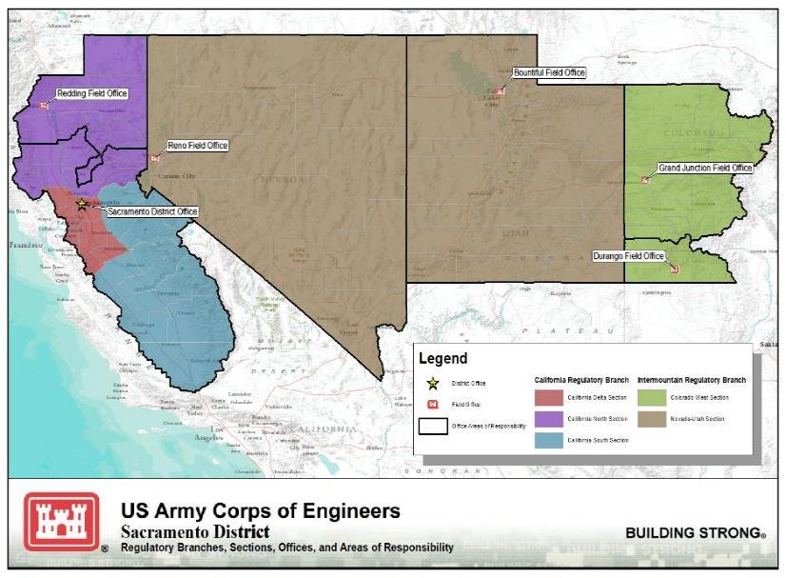
Sacramento District Regulatory Offices

Slide 4
Program Update
National
Navigable Waters Protection Rule
CWA Section 401 Rule
National Environmental Policy Act Regulations
Proposed 2020 Nationwide Permits (33 CFR Part 330)
Regional/State
Regional General Permit 2 for Reservoir Maintenance Activities in CA
Wetland Definition and Procedures for Discharges of Dredged or Fill Material into Waters of the State of CA
404 Permit Strategies Aligned with Regional Habitat Conservation Plans
- East Contra Costa County, South Sacramento County done
- Last is Western Placer County – This fall/winter
Notes:
Navigable Waters Protection Rule (WOTUS definition, 33 CFR Part 328)
- Effective 22JUN20 (except in CO)
- Implementation memos (3/4): Elevation/Coord with USEPA on Certain Determinations; 404 and FSA; 404(f) Ditches;
Clean Water Act Section 401 Certification Rule
- Effective 11SEP20
- Lawsuits
National Environmental Policy Act
- Effective 14SEP20
- Page limit (300) and timeframe 2 years
2020 Nationwide Permits (33 CFR Part 330)
- Early; reviewed triggered by EO to reduce regulation
- Likely to see draft in Aug/Sep
Changes to Compensatory Mitigation Rule (33 CFR Part 332)
- Back-burnered somewhat but in process
- Draft early next year
Wetland Definition and Procedures for Discharges of Dredged or Fill Material into Waters of the State of CA
- State interest in an agreement with Corps on coordinating reviews
404 Permit Strategies Aligned with Regional Habitat Conservation Plans
- East Contra Costa County, South Sacramento County done
- Last is Western Placer County – This fall/winter

Slide 5
Customer Resources
HQUSACE Website (https://www.usace.army.mil/)
National program info
Final and pending permit actions and Approved JDs
Link to National Customer Service Survey
Sacramento District Website (https://www.spk.usace.army.mil, click on “Permits”)
Submit new jurisdiction requests and permit applications electronically
Latest News
Public Notices - sign up!
Regulatory Program Workshop materials
Link to National Customer Service Survey
Regulatory Program Workshops
Next: October 16 in Sacramento
Michael Jewell
(916) 557-6605
michael.s.jewell@usace.army.mil

