Slide 1
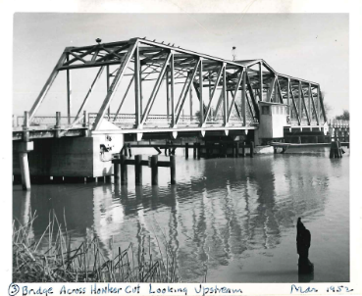
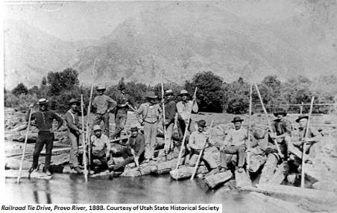
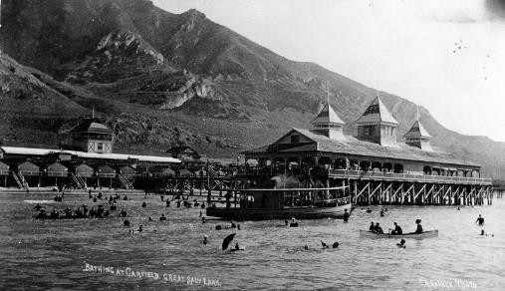
requesting a jurisdictional determination Navigable Waters Protection rule
James T. Robb
Wetlands Specialist / Jurisdiction SME
Sacramento District
23 October 2020
The views, opinions and findings contained in this presentation are those of the author and should not be construed as an official Department of the Army position, policy or decision, unless so designated by other official documentation.
Notes:
Clockwise from middle left: tie drive on Provo River, Utah, 1888 (https://www.utahhumanities.org/stories/items/show/266); bridge across Honker Cut, California, March 1952 (USACE photo); and small steamer on Great Salt Lake at Black Rock Resort c. 1880 (https://archive.sltrib.com/article.php?id=53433968&itype=CMSID)

Slide 2
jurisdiction info needs
All aquatic resources are given a unique name
Maps that include the location of all aquatic resources labeled with their unique name
Maps and unique names that DO NOT indicate jurisdiction status
Map and describe flow path to the TNW
Ditch history
Stream flow characterization WITH DOCUMENTATION
Notes:
Do not indicate the jurisdiction status of the aquatic resource on the map or in the name. The Corps will make the determination by listing the aquatic resource by name on the appropriate table in the AJD form. If your client wants a different map later based on our final verification that’s between you and your client. Having jurisdiction-indicative names or symbols will result in unnecessary and time consuming delays in revisions of maps and tables.

Slide 3
Jurisdiction-indicative names and map symbols result in avoidable revision-caused delays

Slide 4
do not indicate jurisdiction on map
Flow to TNW
WL01
Iso03
Iso02
Iso01
WL02
Intermittent Stream
Ephemeral02
Legend
Isolated Wetland
Ephemeral01
Excluded
Ditch
Adjacent Wetland
Excluded Ditch
Stock Pond
Ephemeral Stream
Intermittent Stream
Stock Pond
Notes:
Indicating jurisdiction in the unique name or with map symbols causes unnecessary delays when revisions are needed (for example WL02 is actually not an adjacent wetland within the meaning of the NWPR because the stream that it abuts is ephemeral.

Slide 5
all aquatic resources should be on the map
Flow to TNW
WL01
Intermittent Stream
Legend
Adjacent Wetland
Intermittent Stream
Notes:
Do not leave aquatic resources off of the map because you don’t think they are jurisdictional.

Slide 6
do not indicate jurisdiction on map
Flow to TNW
WL01
WL04
WL03
WL02
WL05
Reach 1
Reach 3
Reach 2
Legend
Reach 4
Pond01
Wetland
Stream or Ditch
Pond

Slide 7
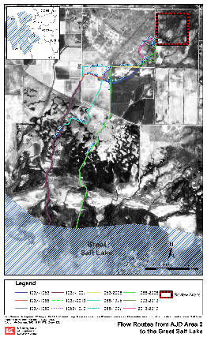
Map and describe flow path to tnw
If you believe a break in jurisdiction (85 FR 22276-80, 21 April 2020) occurs somewhere along the flow path, describe the break, its location, and why you believe it severs jurisdiction.
Notes:
Flow paths can be simple having only one flow path, or complex having many or changing over time, with circumstance, or based on management decisions.

Slide 8
Ditches
When was the ditch constructed?
What was there when the ditch was constructed?
Constructed in a tributary?
Relocate a tributary?
Constructed in an adjacent wetland?
Notes:
Breaks can be simple having only one flow path, or complex having many or changing over time, with circumstance, or based on management decisions.

Slide 9
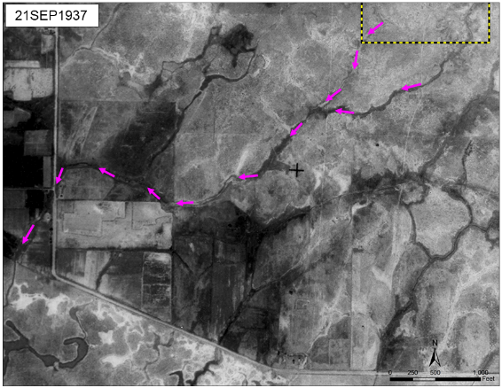
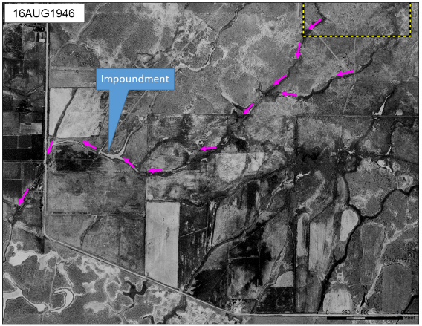
Ditch history - sources
Historic aerial imagery from EarthExplorer (https://earthexplorer.usgs.gov/)

Slide 10
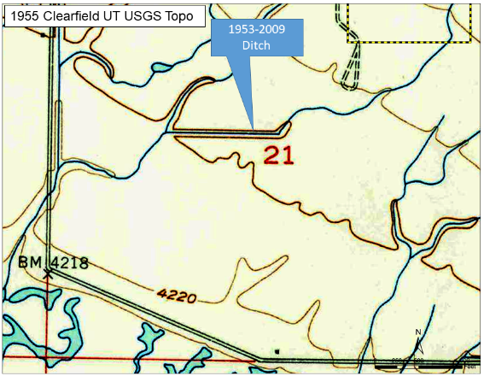
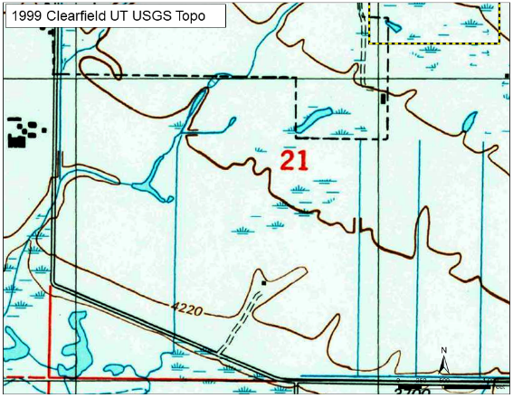
Ditch history - sources
Historic maps from TopoView (https://ngmdb.usgs.gov/topoview/

Slide 11
Ditch history - sources
Historical Documents
Water rights
Irrigation district documents
Water Master Reports
Court cases
Newspapers
Other sources
Local history
Local storm water managers
Water quality agencies
USDA
Local soil and water conservation districts
Zoning / Planning
Interviews with previous landowners

Slide 12
Ephemeral, intermittent, perennial

Slide 13
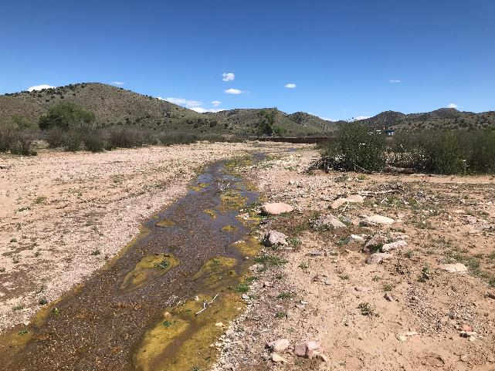
direct observation scenario
Direct observation of water in the channel during the early dry season
The last rainfall, 1/10 inch, was 12 days before the direct observation
3-month antecedent precipitation was drier than the range of normal
The Palmer Drought Severity Index indicates the region was in moderate drought
Notes:
Compelling evidence that this is not ephemeral. At least intermittent but cannot distinguish between intermittent and perennial.
Photo taken by James Robb on 25 April 2019 showing Mangas Creek just above the confluence with Salt River, New Mexico, looking upstream.

Slide 14
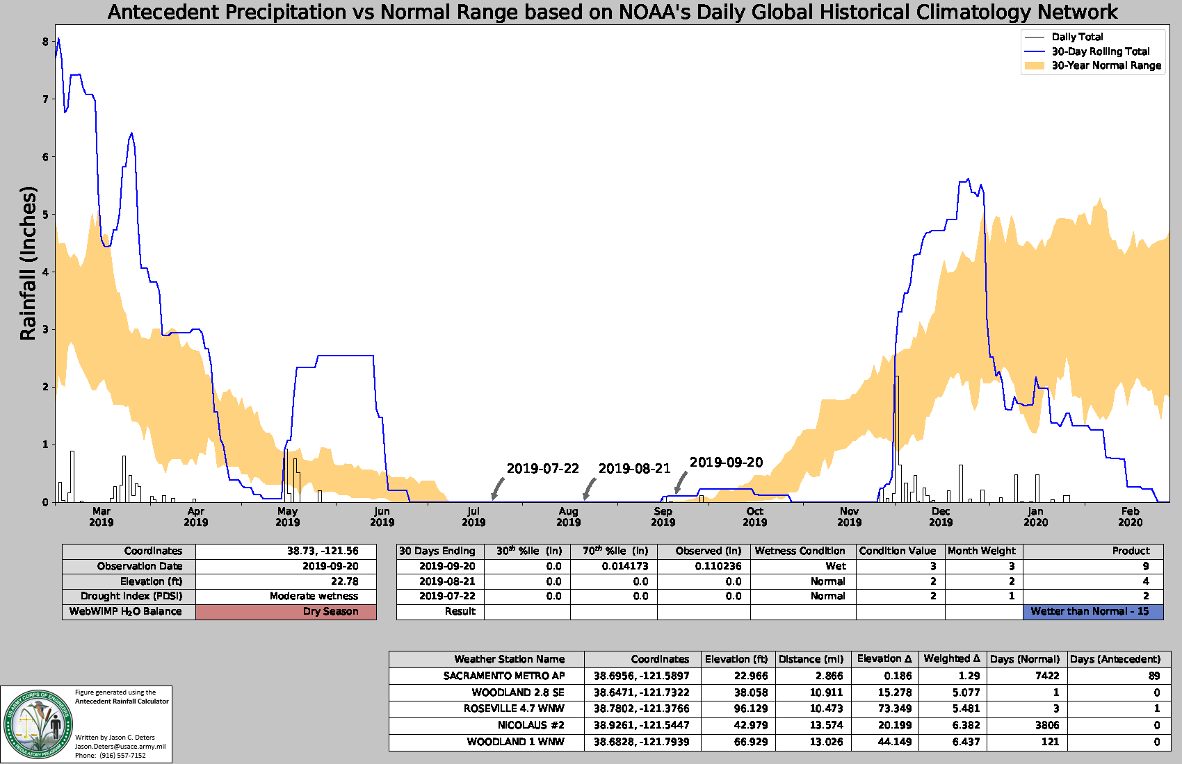
direct observation scenario
Direct observation of a dry channel during the late dry season
The last rainfall, 1/10 inch, was 5 days before the direct observation
3-month antecedent precipitation was wetter than the range of normal
The Palmer Drought Severity Index indicates the region was not in drought
Notes:
Compelling evidence that this channel is not perennial but does not distinguish between ephemeral and intermittent since we would expect an intermittent stream to be dry during the dry season. Don’t get thrown by the wetter than normal antecedent precip. during the dry season in the arid west “normal” is zero precipitation so any amount can give you a wetter than normal reading even though its clearly not enough to cause the stream to flow.

Slide 15
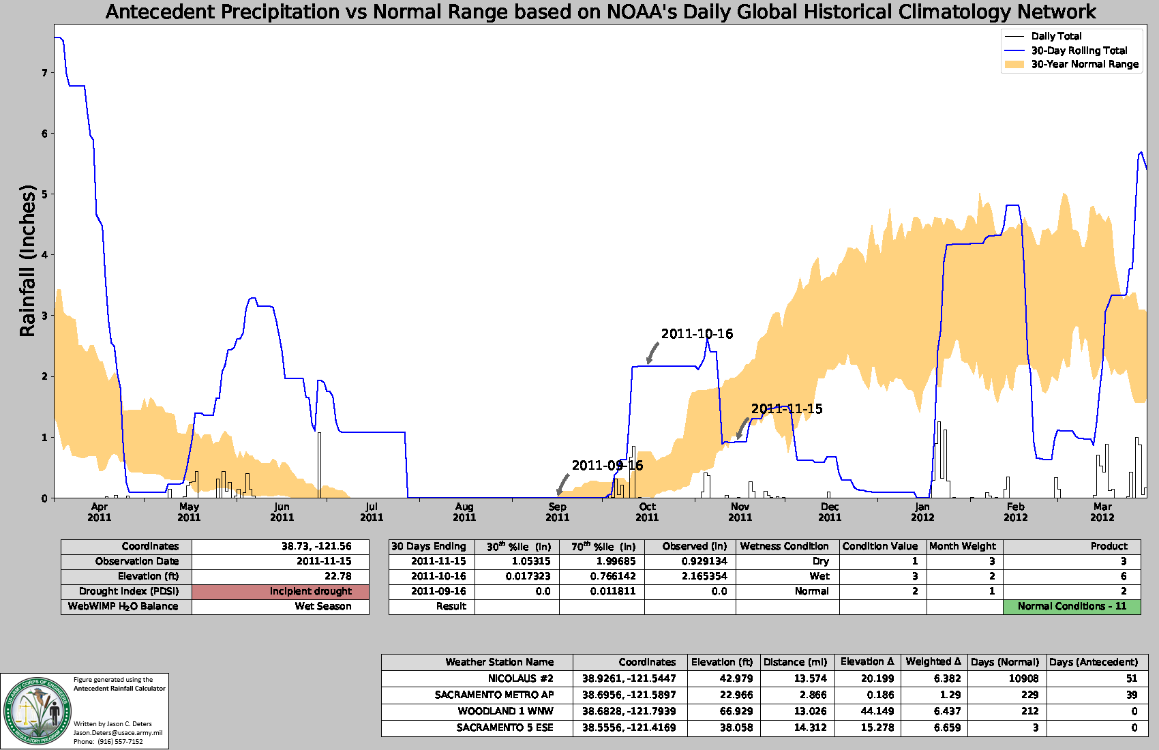
direct observation scenario
Direct observation of dry channel during the early wet season
The last rainfall, 1/10 inch, was 5 days before the direct observation
3-month antecedent precipitation was within the range of normal
The Palmer Drought Severity Index indicates the region was not in drought.
Notes:
Compelling evidence that this is not perennial but does not distinguish between ephemeral and intermittent. In the arid west there is a large soil moisture deficit that must be overcome before intermittent streams flow. This typically happens late in the wet season. Intermittent streams supported by snow pack often do not flow until late spring and into summer.

Slide 16
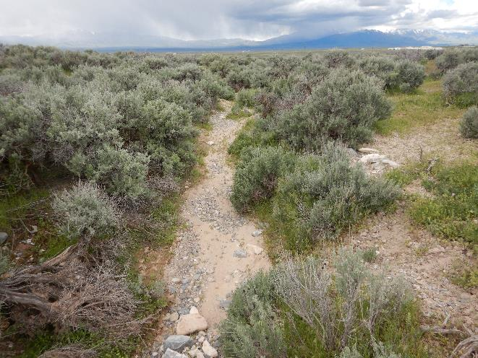
direct observation scenario
Direct observation of dry channel during the late wet season
The last rainfall, 1/10 inch, was 3 days before the direct observation
3-month antecedent precipitation was wetter than the range of normal
The Palmer Drought Severity Index indicates the region was not in drought
Notes:
Compelling evidence that this channel is ephemeral (or at least neither intermittent nor perennial. Even though conditions were wetter than normal and the observations occurred at the best time of years to see the stream flow, the stream channel was dry.
Photo taken by Matt Wilson at Tooele Army Depot, Utah, on 9 May 2019.

Slide 17
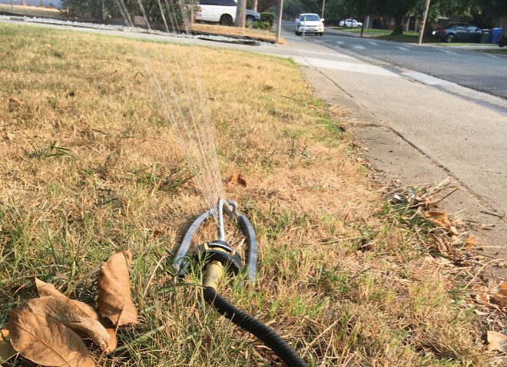
direct observation scenario
Direct observation of water in the channel during the dry season
The last rainfall, 1/10 inch, was 60 days before the direct observation
3-month antecedent precipitation was within the range of normal (i.e. near zero)
The Palmer Drought Severity Index indicates the region was in mild drought
The summer water source is excess water from upstream lawn watering
Notes:
Compelling evidence that this channel is perennial. There is water in the channel even during the dry season in a mild drought. The artificial sources of water are not discounted by the Navigable Waters Protection Rule.
Photo taken by James Robb, 30 August 2020, Sacramento, California

Slide 18
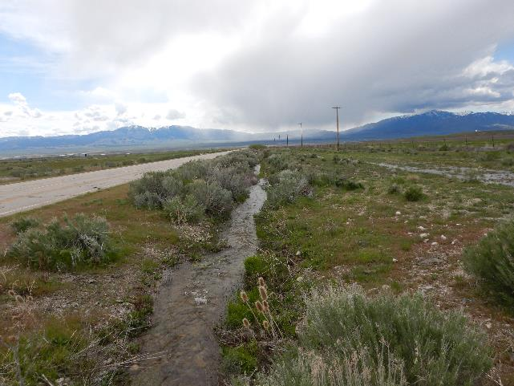
direct observation scenario
Direct observation of water in the channel during the late wet season
The last rainfall was two days before the direct observation
3-month antecedent precipitation was within the range of normal
The Palmer Drought Severity Index indicates the region was not in drought
Notes:
All three categories of stream would be expected to flow in this scenario. Info provided would not differentiate. A single direct observation is not always going to answer the question.

Slide 19
aerial imagery
Observations over time using aerial imagery
Typical year analysis (e.g. seasonality, drought, antecedent precipitation) provides context to interpret aerial imagery
Notes:
Aerial imagery extends your ability to make observations over time.

Slide 20
What’s the same
Delineation and Verification
RGL 16-01
Request for Aquatic Resources Verification or Jurisdictional Determination
Map and drawing standards
Delineation report standards

Slide 21
More info
Navigable Waters Protection Rule: Definition of Waters of the United States” (85 FR 22250-22342, April 12, 2020)
Overview of the Navigable Waters Protection Rule – Fact Sheet
Mapping and the Navigable Waters Protection Rule – Fact Sheet
Implementing the Navigable Waters Protection Rule – Fact Sheet
Rural America and the Navigable Waters Protection Rule – Fact Sheet
“Typical Year” and the Navigable Waters Protection Rule – Fact Sheet
Navigable Waters Protection Rule Photo Appendix
Questions about the Regulatory Program?
(916) 557-5250
CESPK-REGULATORY-INFO@USACE.ARMY.MIL
https://www.spk.usace.army.mil/Missions/Regulatory.aspx
https://www.epa.gov/nwpr/navigable-waters-protection-rule-step-two-revise#mats
https://www.epa.gov/nwpr/final-rule-navigable-waters-protection-rule
https://www.epa.gov/nwpr/navigable-waters-protection-rule-factsheets

