Slide 1
FOLSOM DAM MODIFICATIONS APPROACH CHANNEL EIS/EIR
Major Robert Dion
and Cameron Sessions
Project Managers
Sacramento District, USACE
23 August 2012

Slide 2
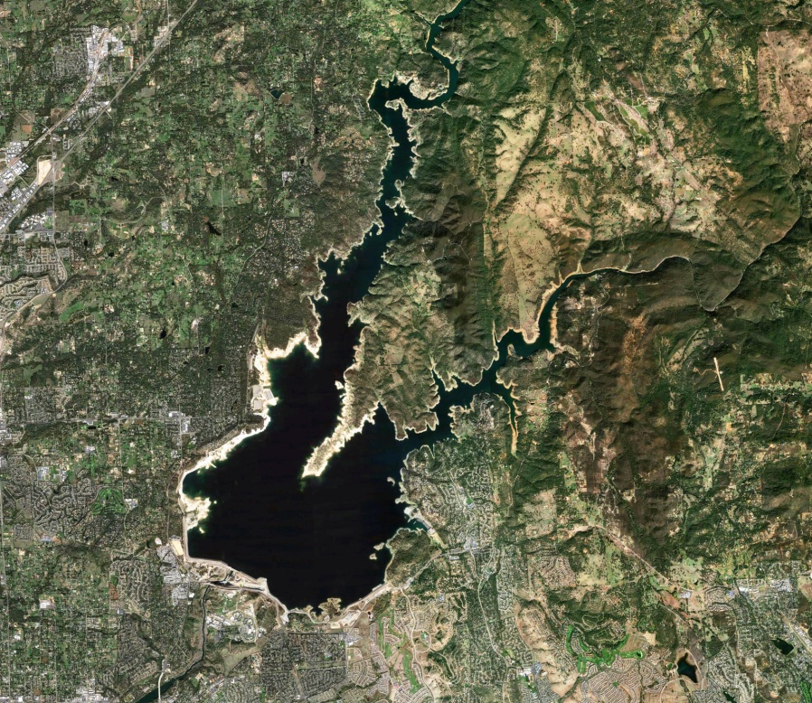
PURPOSE & AGENDA
Purpose: Introduce the Approach Channel phase of the Folsom Dam Auxiliary Spillway Project (Joint Federal Project), explain the environmental assessment process, and acquire community feedback
Agenda:
Background
Project Overview
Facts and Figures
Schedule
Project Phases
Environmental Policies
Question/Answers
Notes:
2

Slide 3
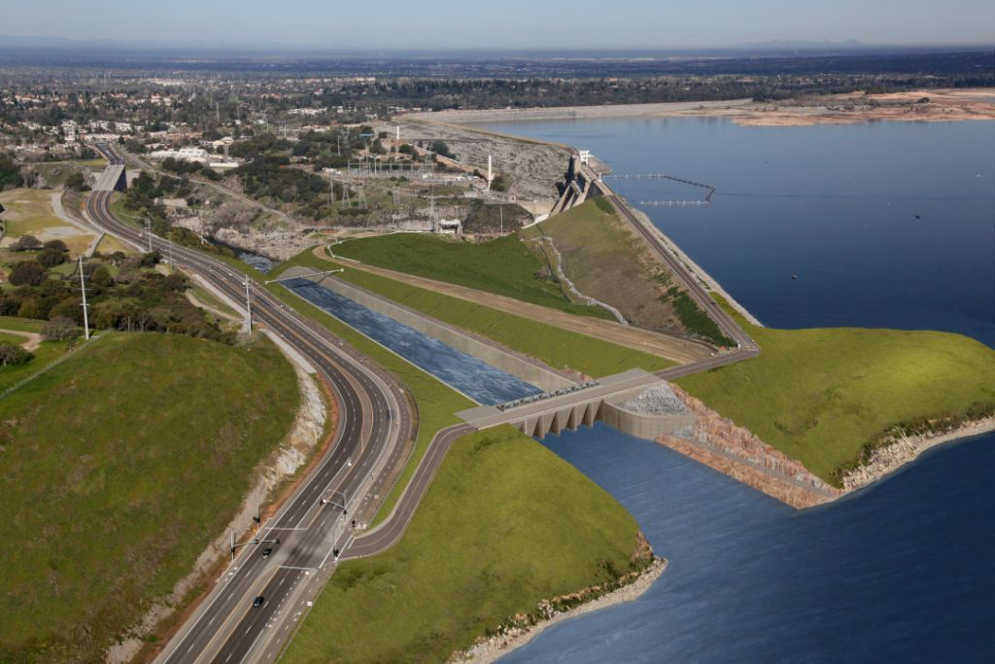
BACKGROUND
What will the project do?
Folsom Reservoir currently does not
have sufficient capacity for advance
releases in preparation for a very
large flood event.
The new auxiliary spillway will manage
these large storms by constructing a new spillway with 6 new gates at a lower elevation to allow more water to be safely released earlier in a storm event. Also, additional storage will be available in the reservoir to hold the peak inflows.

Slide 4
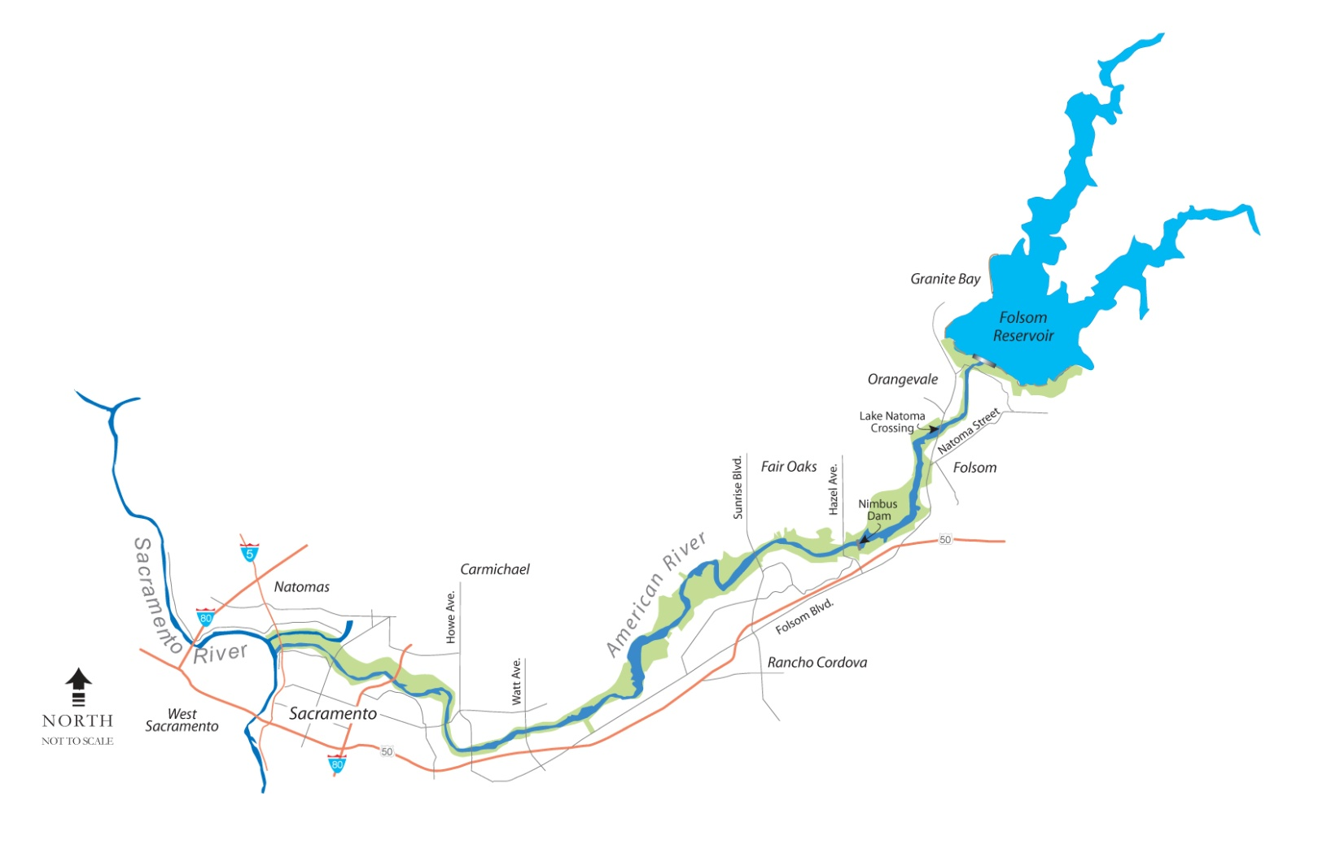
BACKGROUND
Located about 25 miles east of Sacramento, the Folsom Dam Modifications must work in conjunction with upgraded levees downstream to achieve a 1 in 200-year level of protection.
Notes:
(advance slide to play video)
Notes:
This map shows the location of the dam, just east of Sacramento – the state capitol. Folsom’s water releases flow down the American River, through the city of Sacramento, into the Sacramento River and out to sea.
Notes: Total Project cost - $833M
Federal Cost - $541.5M
Non-Federal - $291.5M
Total cost through FY10 - $119M
FY11 allocations to date - $9.9M (??)
FY 12 President’s Budget - $21M ($28M can be executed)
902 Limit - $962M
Inset map shows the JFP in relation to the rest of the American River Common Features General Reevaluation Report work currently underway. To reach “200 year” protection, both the JFP AND the downstream levee work must be complete. Otherwise, the downstream levees wouldn’t be able to hold the increased water releases from the dam.
The Control structure and spillway are designed to release 312,500 cf of water per second…about twice the capacity of the downstream channel, if the main dam is in danger of overtopping during an extreme event.

Slide 5
FOLSOM DAM MODS OVERVIEW
The Folsom Dam Auxiliary Spillway Project is a $962-million cooperative effort between the U.S. Army Corps of Engineers and the U.S. Department of the Interior, Bureau of Reclamation.
This project will help the Sacramento region achieve a 200-year level of protection, meaning a one-in-200 (.05%) chance for flooding in any given year.
By working together, the Corps and Reclamation will be able to complete the project faster and more cost effectively than if constructed separately.
Non-Federal Sponsors:
Central Valley Flood Protection Board
CA Department of Water Resources
Sacramento Area Flood Control Agency

Slide 6
FACTS AND FIGURES
The new auxiliary spillway will operate in conjunction with the main dam facility and includes:
1,100 foot approach channel
control structure with six submerged tainter gates
3,000 foot long spillway chute
stilling basin that acts as an energy dissipater
The new spillway project will:
Require excavation of more than 3.5 million cubic yards of rock and soil
Placement of 250,000 cubic yards of concrete, and
Incorporate more than 30 million pounds of steel reinforcing

Slide 7
SCHEDULE
The spillway is being constructed in a phased-approach:
Phases 1 & 2: Was completed by the Bureau of Reclamation in January 2011; the first two phases involved a significant amount of excavation at the site
Phase 3: Construction of the control structure that houses the 6 large Tainter gates is currently underway and is expected to last 45 months
Phases 4: Construction of the chute and stilling basin and approach channel.
Phase 5: Restoration of the project site and commissioning.
Today’s effort will focus on the approach channel construction in Phase 4 and Phase 5.

Slide 8
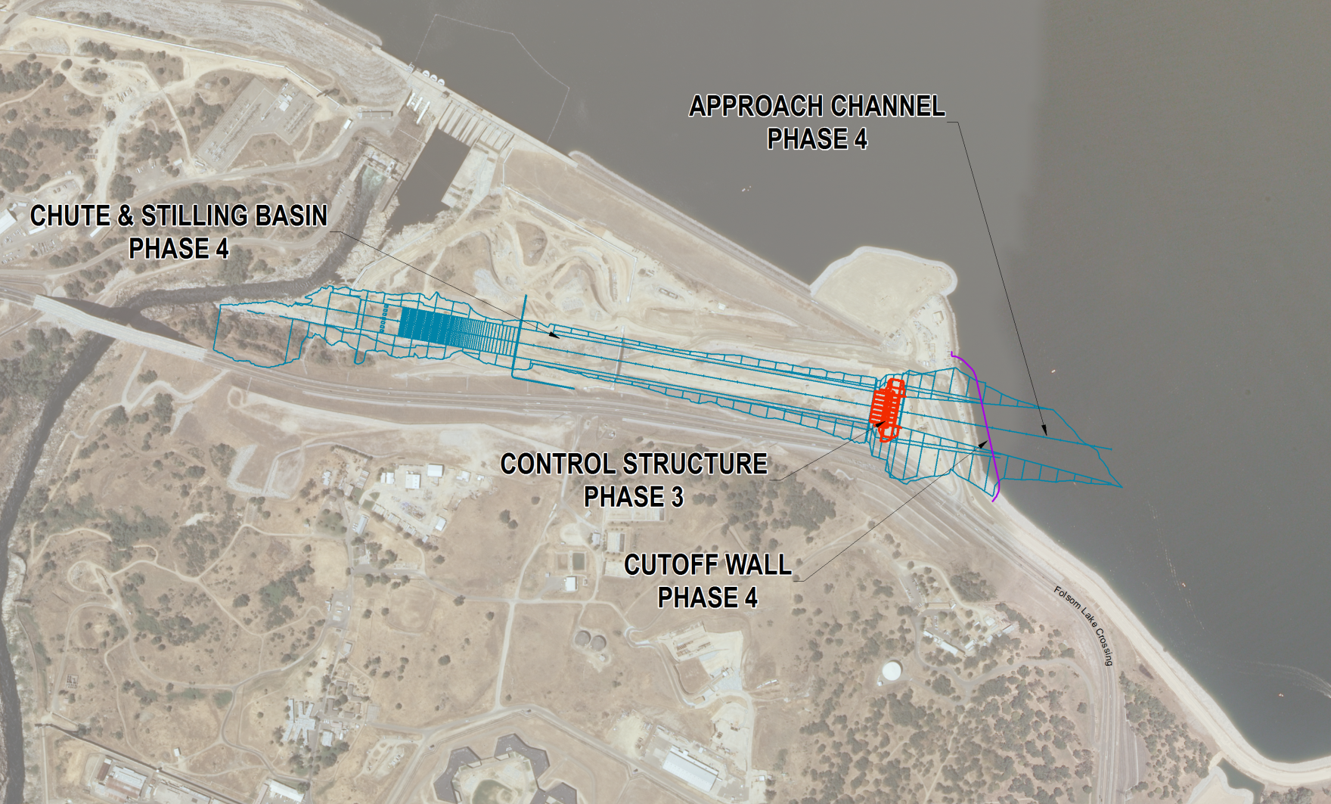
Project Phases
Notes:
8

Slide 9
APPROACH CHANNEL
Construction of a 1,100 linear foot inlet channel from Folsom Lake to the control structure
The channel inlet will include a temporary cut-off wall or cofferdam structure to allow excavation work to occur in dry conditions for the approach channel
Final design expected Dec 2012
Project Award May 2013

Slide 10
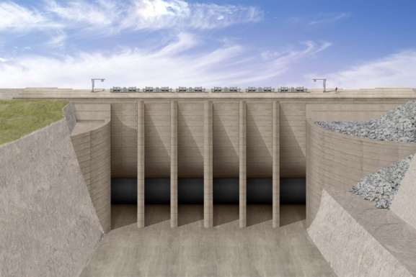
APPROACH CHANNEL Potential Effects
In-water Blasting and Dredging
Currently assessing effects (turbidity, etc)
Best Management Practices will be implemented
Silt/turbidity curtains utilized
Minimize impacts to recreation
Preferred Alternative Identified
Alternative 2 will use cut-off wall
during construction

Slide 11
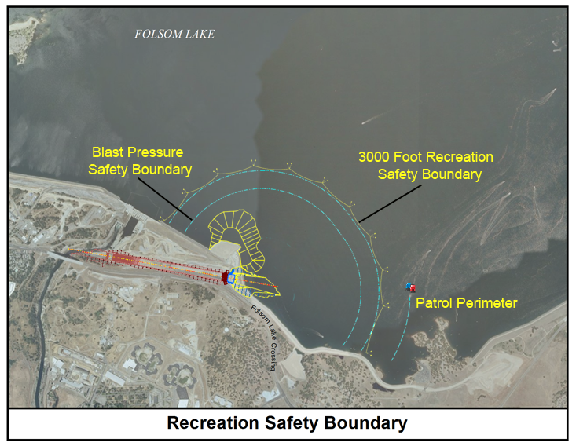
Test Blasting
Up to 8 test blasts to be conducted to verify safety boundaries
Test blasting may last up to a week
3000’ recreation safety zone
Patrol unit
Blast Pressure Safety
Boundary – Pressures
to be monitored within
2,500’ to ensure public
safety

Slide 12
Prison Staging Area and Stilling Basin Drain
Additional design refinements are being evaluated within an EA/EIR which includes:
Use of 10 acres at Folsom State Prison for staging and potential operation of a concrete batch plant,
Installation of a temporary traffic signal on Folsom Lake Crossing,
Widening of an existing dirt access road, and
Construction of a drain at the stilling basin.

Slide 13
National Environmental Policy Act
A process outlined under federal law
Assesses proposed Federal actions through a range of Alternatives to determine if there is potential significant impact on the environment
Allows the public an opportunity to be involved with the decision process
Provides community involvement
Public Scoping Meetings
Public Comment review periods
Public hearings

Slide 14
California Environmental Quality Act
A process outlined by California state law that:
Informs decision makers and the public about the potential significant environmental effect of a project.
Identifies project changes, alternatives, or mitigation measures to avoid or significantly reduce environmental effects, when feasible.
Discloses to the public, the reasons why a project was approved if significant environmental effects are involved.
Provides community involvement
Public Scoping Meetings
Public Comment review periods
Public hearings

Slide 15
PROPOSED
ACTION
ENVIRONMENTAL
ASSESSMENT
NOTICE OF INTENT/PREPARATION
October 2011
SCOPING PROCESS
DRAFT EIS/EIR
YOU
ARE
HERE
AGENCY/PUBLIC REVIEW AND COMMENT
FINAL EIS/EIR
RECORD OF DECISION/ NOTICE OF DETERMINATION
AGENCY ACTION

Slide 16
Public Participation
A draft supplemental Environmental Impact Statement (EIS)/ Environmental Impact Report (EIR) is currently provided for public comment.
The approach channel EIS/EIR constitutes a supplemental document to the 2007 EIS/EIR Folsom Dam Safety and Flood Damage Reduction document.
Opportunities for public input
Public review of the draft Supplemental EA/EIR: 12 July – 27 August 2012
Public review of the draft EIS/EIR: 25 July – 10 September 2012
Public review of the final EIS: 31 December 2012 – 29 January 2013
You can participate today by submitting written comments to any member of our team.

Slide 17
Q & A Reminders
The design is not final and effects have not been fully assessed.
Please provide any written comments to the team. Formal comments may be submitted on the provided comments card and mailed. Comments may also be provided to the website.
Staff will be here about one hour. Feel free to ask any questions and we’ll try to help. If you’d like to depart, we want to thank you for your attendance.
Now, we’ll take some questions to clarify points of the presentation. Please focus questions and discussion on items specific to the Approach Channel phase.

